Slide 1

18ECE340T- MACHINE PERCEPTION WITH COGNITION
UNIT-1
Numericals

Slide 2
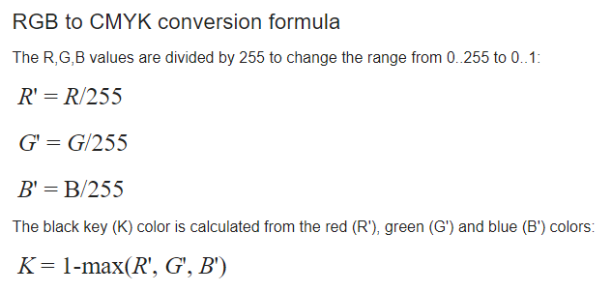
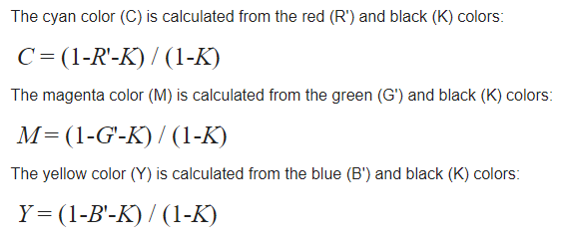
RGB to CMYK Conversion Formula

Slide 3
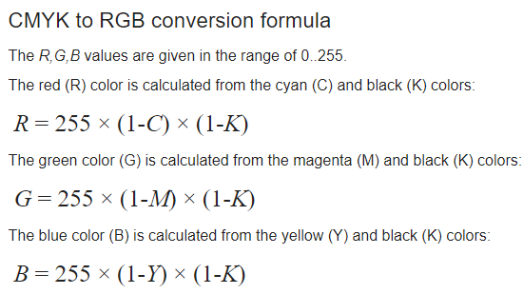
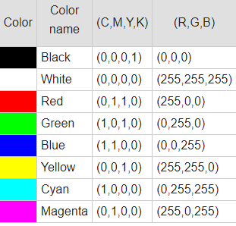
CMYK to RGB Conversion Formula

Slide 4
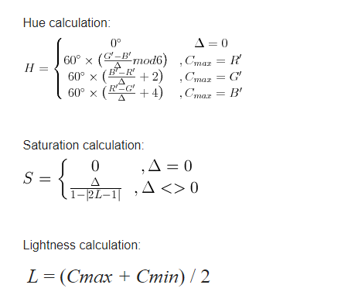
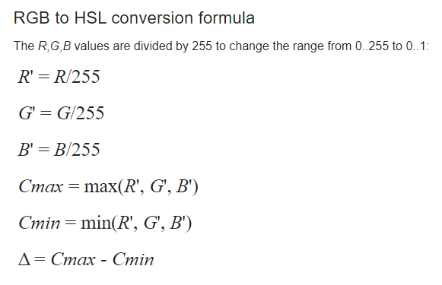
RGB to HSL Conversion Formula

Slide 5
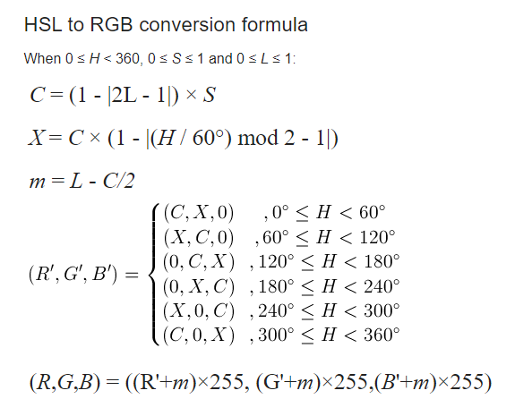
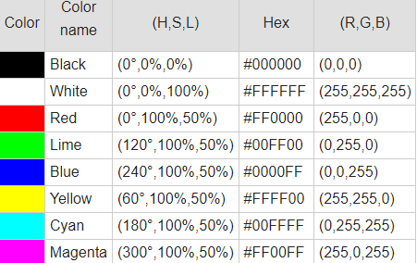
HSL to RGB Conversion Formula

Slide 7
Conversions:
RGB to YUV Conversion
Y = 0.299R + 0.587G + 0.114B
U'= (B-Y)*0.565
V'= (R-Y)*0.713

Slide 8
Algorithm
Approach :
Divide r, g, b by 255
Compute cmax, cmin, difference
Hue calculation :
if cmax and cmin equal 0, then h = 0
if cmax equal r then compute h = (60 * ((g – b) / diff) + 360) % 360
if cmax equal g then compute h = (60 * ((b – r) / diff) + 120) % 360
if cmax equal b then compute h = (60 * ((r – g) / diff) + 240) % 360
Saturation computation :
if cmax = 0, then s = 0
if cmax does not equal 0 then compute s = (diff/cmax)*100
Value computation :
v = cmax*100

Slide 9
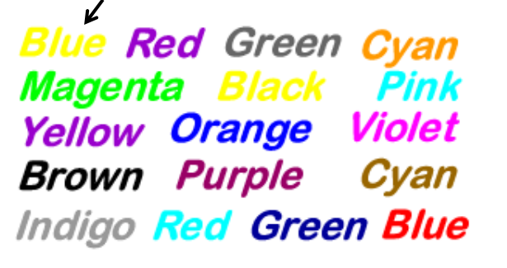
Let’s Try
Hi Students
Please, before leaving try to name the colours as quick as you can, Hint for the first one: YELLOW

Slide 10
Color to Grayscale Conversion
Grayscale = 0.299R + 0.587G + 0.114B
RGB to Grayscale Conversion
Methods to convert an RGB image to a grayscale image, like Average Method and Weighted Method.
(1) Average Method
(2) Weighted Method
Grayscale = (R + G + B ) / 3
Grayscale = R/3 + G/3 + B/3
The weighted method, also called the luminosity method, weighs red, green, and blue according to their wavelengths. The improved formula is as follows:
Grayscale = 0.299 R + 0.587 G + 0.114 B

Slide 11
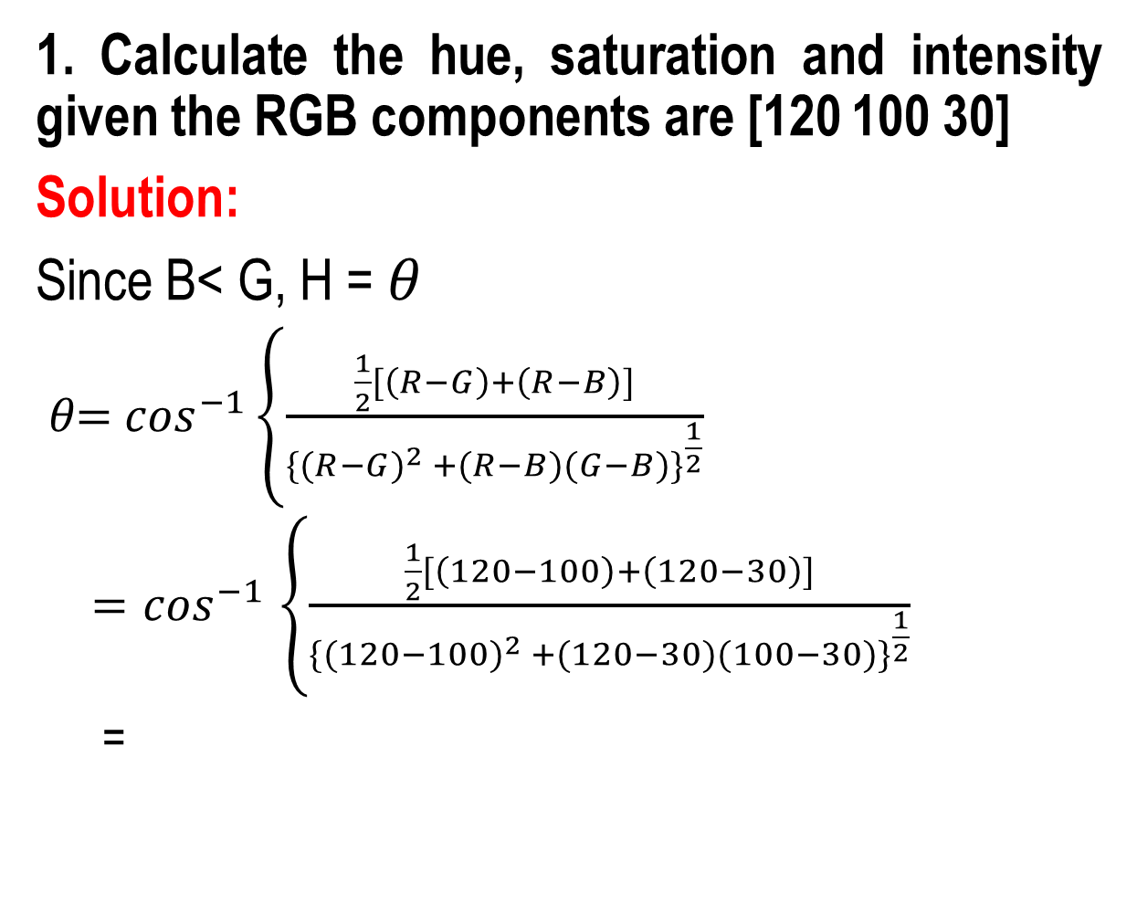
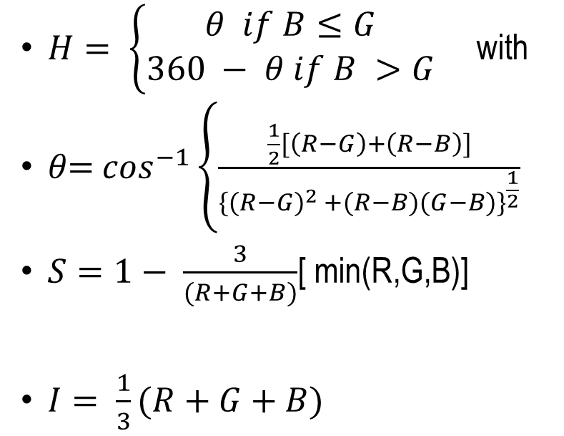
Converting colors from RGB to HSI

Slide 12
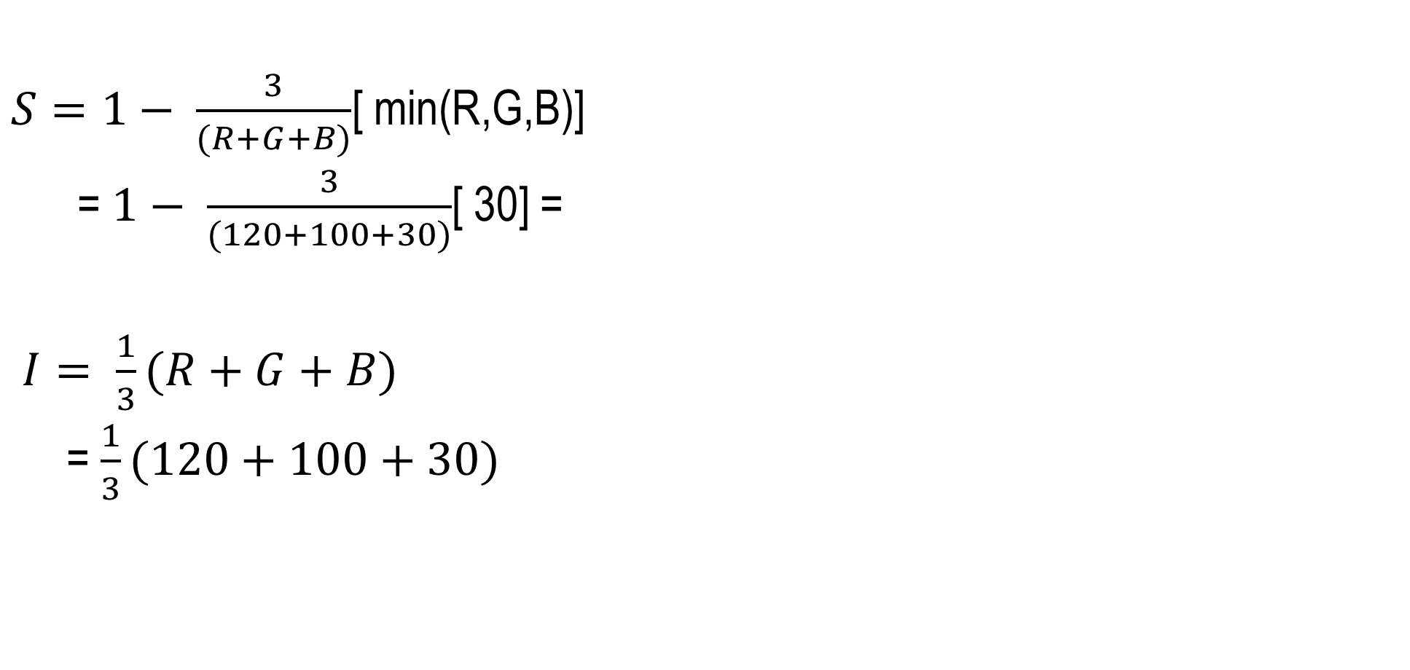
Converting colors from RGB to HSI

Slide 13
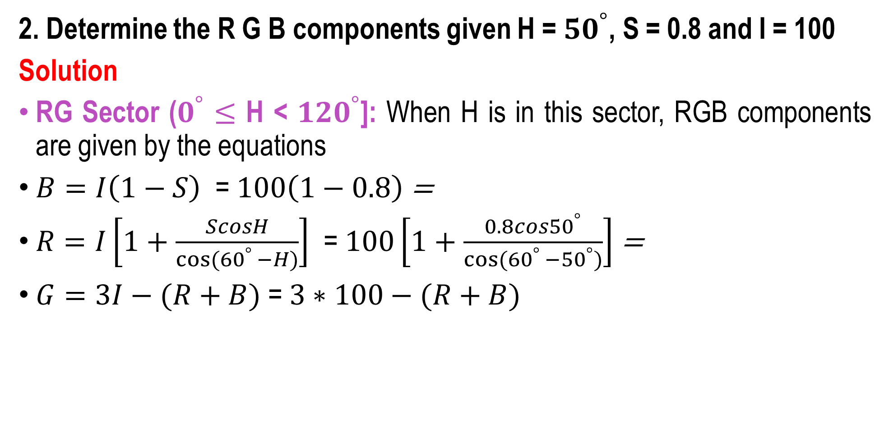
Converting colors from HSI to RGB

Slide 14
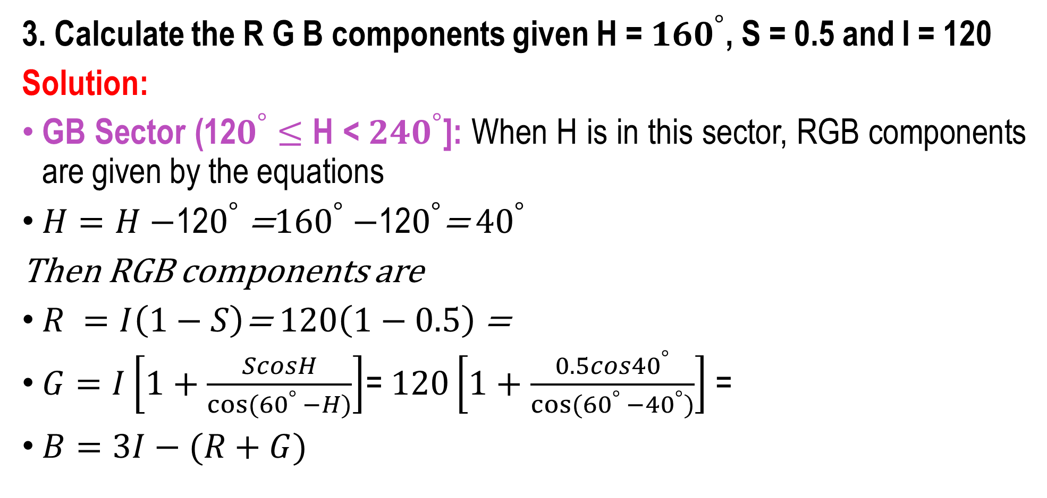
Converting colors from HSI to RGB

Slide 15
Applications
RGB Model:
Representation and display of images in electronic systems like computers and televisions.
Used in conventional photography
Image scanner which scans images and converts it to a digital image mostly supports RGB color.
Used in web graphics.
CMY Model:
Used in color printing as it uses colored inks.
Used in most commercial printing like magazines, books, etc.
HIS Model:
The biggest application of this model is that it represents colors similarly to how the human eye senses colors

Slide 16
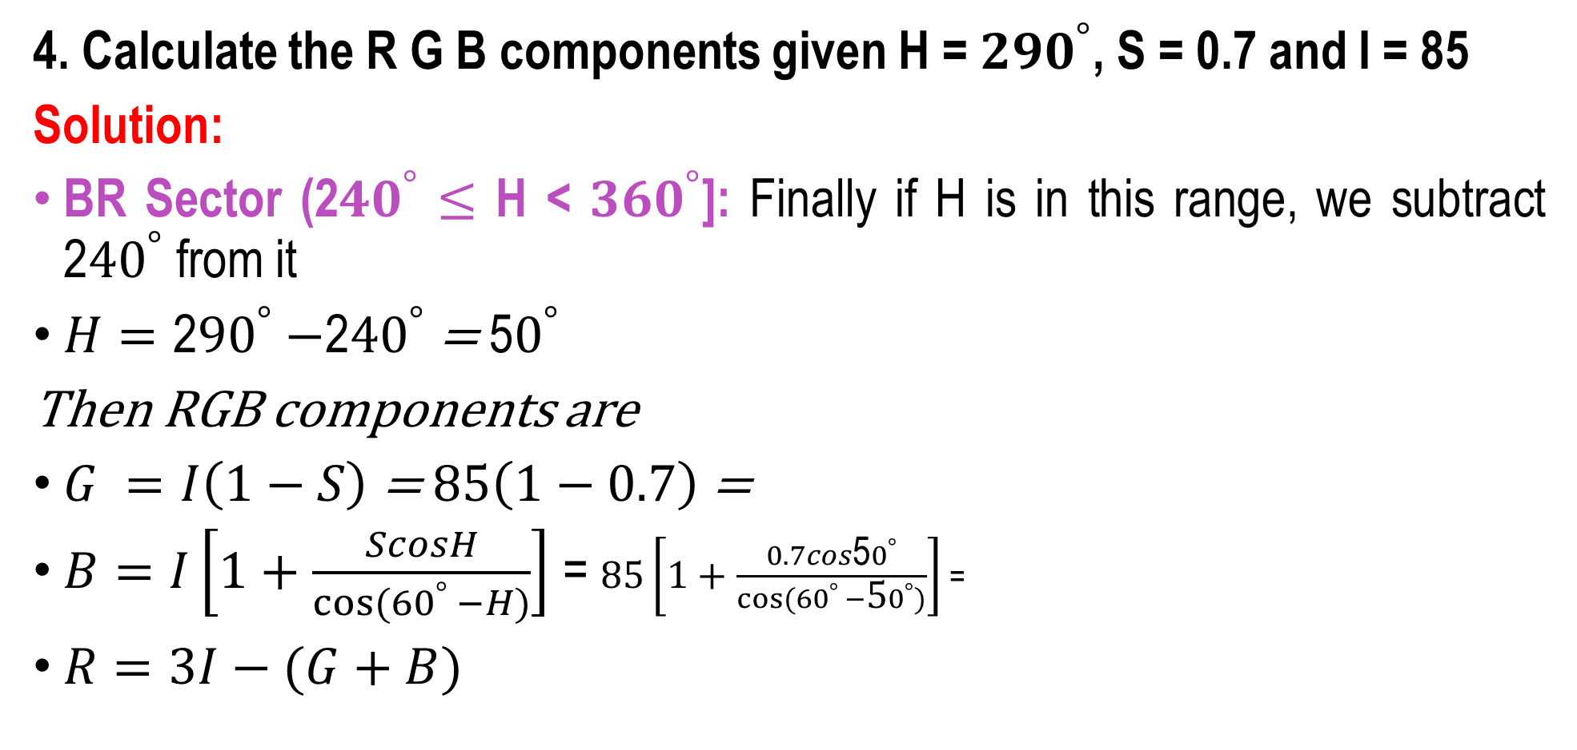
Converting colors from HSI to RGB

Slide 17

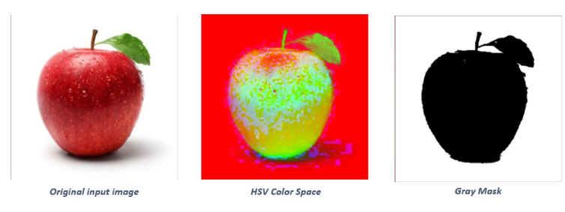

Colour Conversion and Contouring

Slide 18
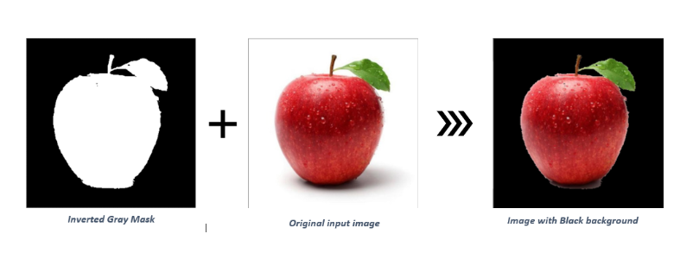
Image Representation

Slide 19
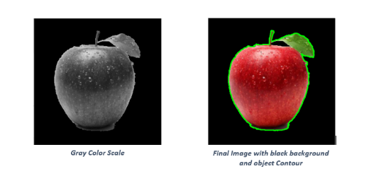
Image Representation

